Slide 1
Use of Response Functions to Administer Water Rights
AWSE Spring Meeting
Salt Lake City, Utah
June 2015
Michael Sullivan

Slide 2
Integrating Groundwater and Surface Water Administration
Water Admin: Daily on/off of water rights
Well depletions impact streams
Can’t directly measure depletions so use model to determine impact:
Glover/AWAS/Finite Difference Model
Simple system = simple model
Complex system = complex model
More complex makes prediction difficult.
Use RF to distill historic results to predict future

Slide 3
Delayed Depletions
Notes:
This is a graph showing the time-dependent nature of stream depletions due to ground water pumping.
The H axis is time, ZERO is at the beginning of our episode of well pumping.
The V axis is the RATE at which we are pumping.
So in the turquoise color, we have, say 1 ac-ft/day pumped, for 100 days = volume of 100 Ac-Ft pumped, and then the well pump is turned off.
In the blue color, we have the response at the stream: depletions, in the form of leakage from the stream into the aquifer, MANIFESTED as LESS STREAMFLOW, happens but not instantaneously. Instead there is a time lag- the depletions are spread out over time.

Slide 4
Notes:
This shows the complexity of confined responses. Now think about both these going on at the same time.

Slide 5
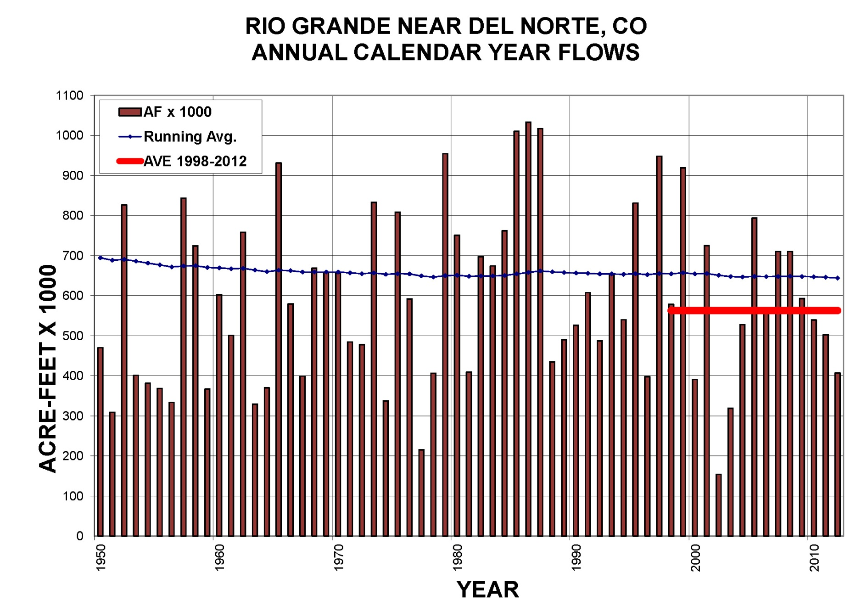
Drought
Notes:
An example of input variability.

Slide 6
Modeling
Notes:
Basic modeling inputs

Slide 7
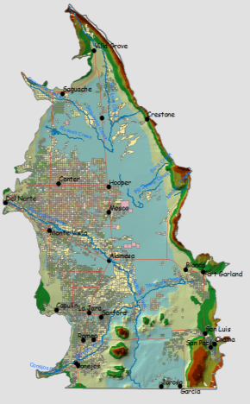
HydroBase
GIS Data (Spatial Data)
CDSS Tool Box & StateDGI
TSTool & StateDMI
StateCU
MODFLOW
Notes:
Developed Data Centered model so we can continue to update the model without rebuilding it

Slide 8
Why RF’s
Complexity of systems, quick analysis of impacts
Example: South Platte vs. Rio Grande Basin
Results model vs. Prediction model
Ease of use for users
Scenarios to build funding case for GWMP
Short time frame for ARP
Notes:
RF is a distillation of model to allow ‘predict’ short time

Slide 9
Sangre de Cristo Mountains
Confining Clays
San Juan Mountains
San Luis
Hills
Notes:
Geologic bounds within the groundwater model. Framework includes all geologic information collected on the valley.

Slide 10
Irrigated acreage
Notes:
These are some of the inputs we use for the DSS. Irrigated acreage updated in the database either annually or every 5 years depending on data availability and change.

Slide 11
Location of wells with metered diversion records
Notes:
Information in the model structure and data inputs (meter data) going forward.

Slide 12
Diversion structures
Streamflow gages
Climate stations
Notes:
More structural parts of the model and data each year.

Slide 13
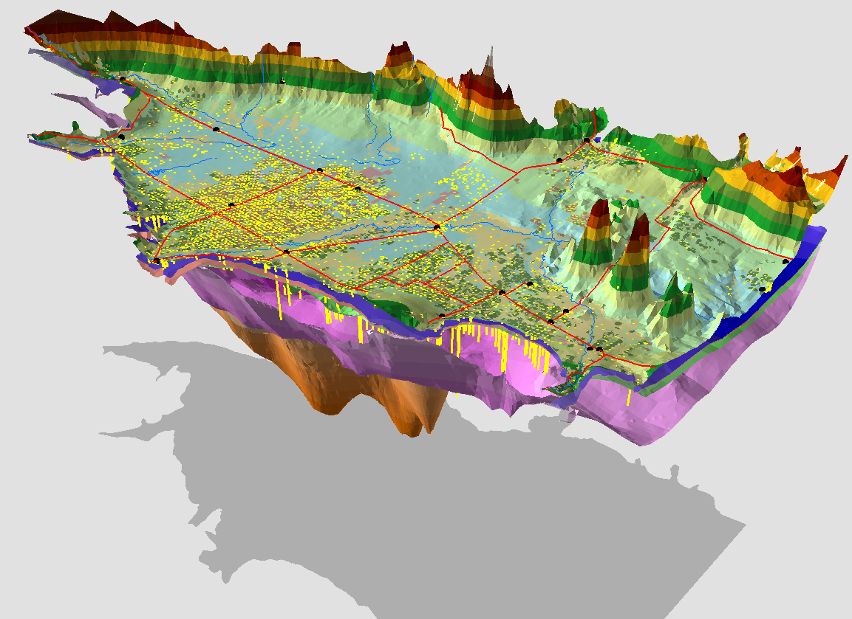
Saguache
Center
Alamosa
Monte Vista
Conejos
San Luis Valley Overview
Looking Northeast
Vertical Exaggeration = 10x
Notes:
So here is the block model

Slide 14
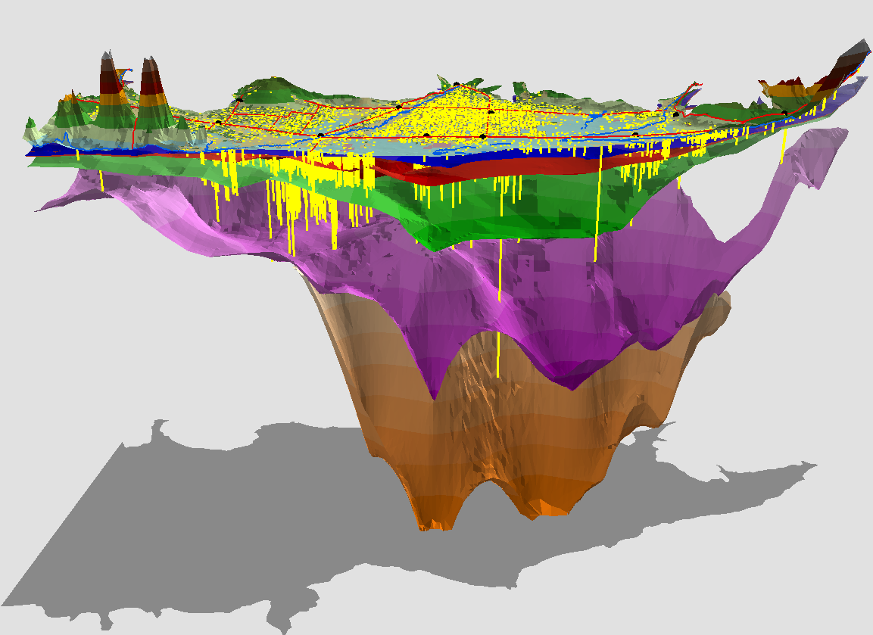
Conejos
Monte Vista
Saguache
Alamosa
Center
San Luis Valley Cut Away
Looking West
Vertical Exaggeration = 10x
Notes:
This shows the 5 layers we use in the model.

Slide 15
HydroBase
GIS Data (Spatial Data)
CDSS Tool Box & StateDGI
TSTool & StateDMI
StateCU
MODFLOW
Notes:
So again this is the basic DSS structure we use but in reality it looks like this….

Slide 16
Decision Support Process
Notes:
This could get a bit complex in trying to do predications. Lots of data to ‘guesstimate’ for each prediction run.

Slide 17
Model output
Notes:
All those inputs generate massive output files

Slide 18
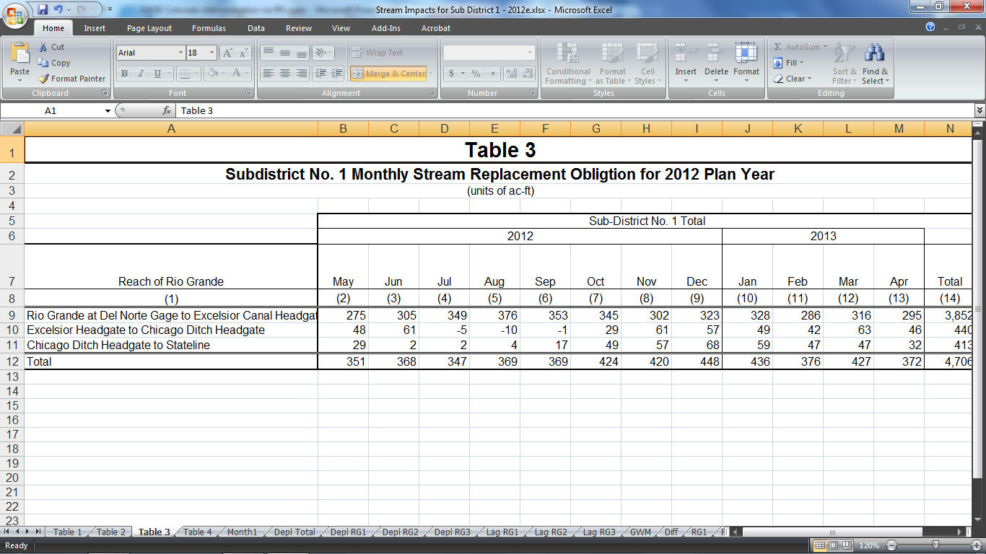
Response Function
NGWCU, Forecast Streamflow, Year Type
Notes:
Distilling down those output files from a 23 year run of the GW model (which is populated by the DSS data for 23 past years).

Slide 19
Response Areas
Notes:
Proposed response areas for the regional model to give us area impacts.

Slide 20
Annual Replacement Plan
Projected NGWCU
Projected year
RF used
Water Supply for replacement
Agreements
Long term coverage of extended depletions
Notes:
Each RA will have a set of RF’s to use for each ARP. Additional data will be to administer the ARP

Slide 21
Daily Administration
Table 3 used to determine replacement daily
Water users tell what source to use each day
If conditions change (snowpack) may be able to respond with an amendment
End of year review
Notes:
Water deliveries, forbearance agreements, contracts, etc for source/remedy.
Interaction with water commissioners to assure ‘remedy’ each day.

Slide 22
Questions???

